Slide 1
DevOps Big Picture
Notes:
https://courses.cs.washington.edu/courses/cse403/13au/lectures/git.ppt.pdf
http://enos.itcollege.ee/~jpoial/allalaadimised/git/getting-started-with-git.pdf

Slide 2
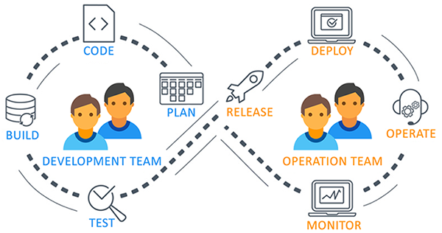
What and why of DevOps?

Slide 3
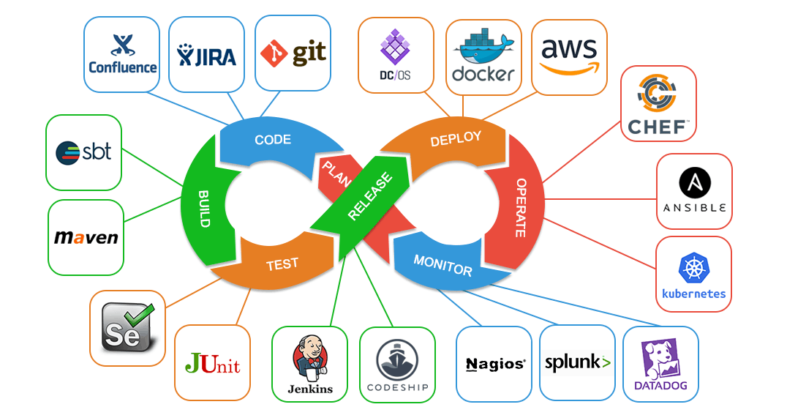
What and why of DevOps?

Slide 4
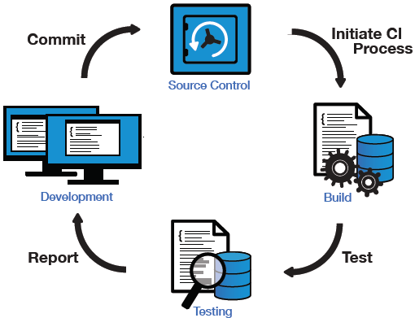
Continuous Integration

Slide 5
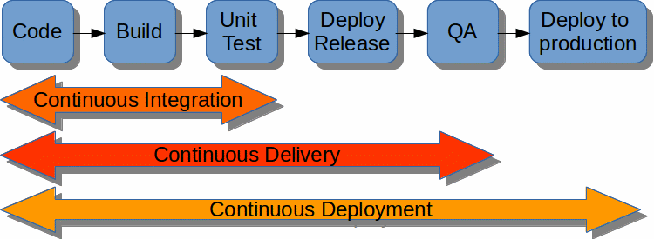
Continuous Delivery and Deployment

Slide 6
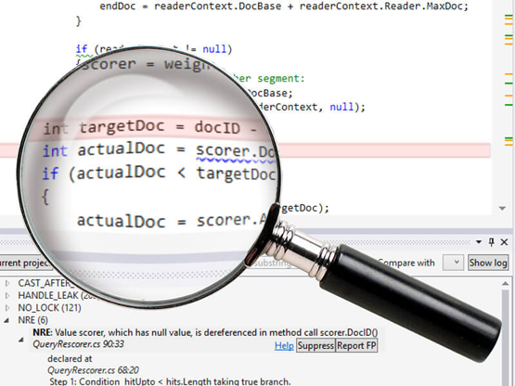
What Is Static Code Analysis?
A method of debugging
Examine source code before a program is run
Done by analyzing a set of code against a set of coding rules.
Performed early in development

Slide 7
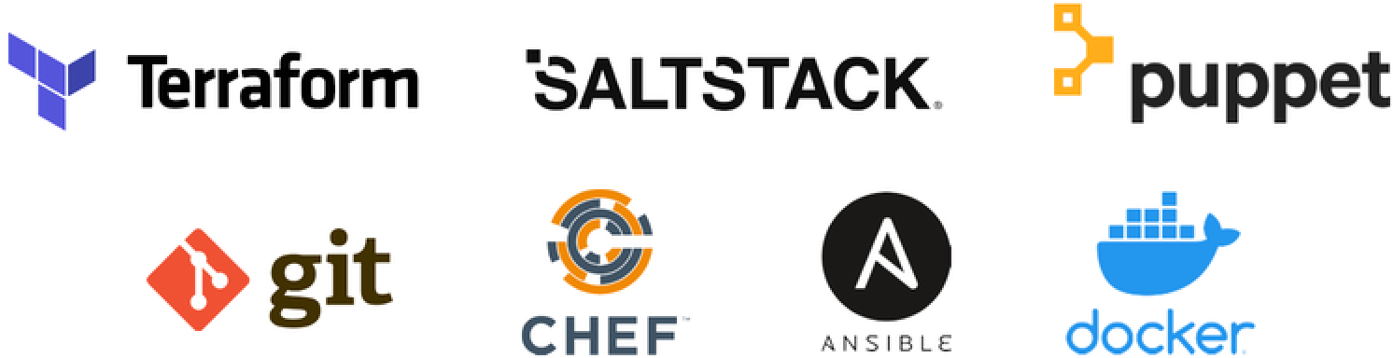
Configuration Management Tools

Slide 8
Thanks

